Slide 1

Natural Language Processing Comp237

Slide 2
Members
Lxxxxxx Wxxx
Wing Yan Lau
Sxx Mxx Txxx

Slide 3

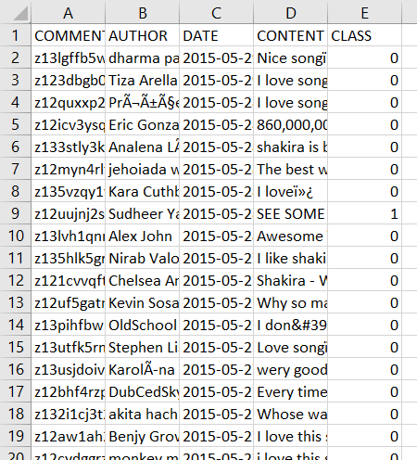
Youtube05-Shakira.csv
We load “Youtube05-Shakira.csv” file into a Pandas data frame.

Slide 4
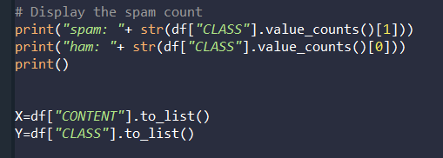
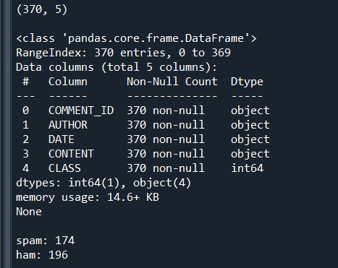
Basic Data Exploration
For this project we use only the “CONTENT” and “CLASS” columns.

Slide 5
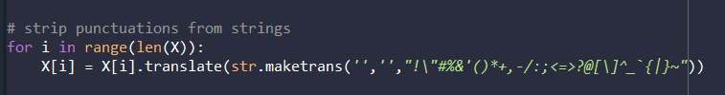
Preprocessing
For pre-processing, we strip all the punctuation marks from the comments in CONTENT column

Slide 6
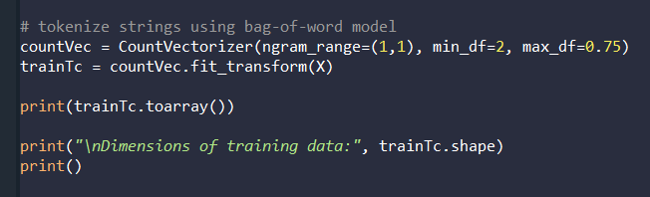
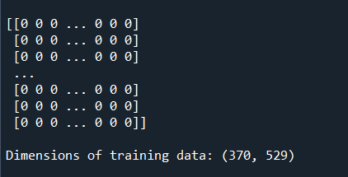
Vectorization
We then use count_vectorizer to tokenize and vectorize all the comments using the bag of words model. We use min_df=2 to ignore words that are in less than 20% of comments, and use max_df=0.75 to ignore words that are in more than 75% of comments. We use CountVectorizer’s default list of stop words. The dimension of our vectorized comments data is (370, 529), meaning our bag of word model contains 529 features.

Slide 7
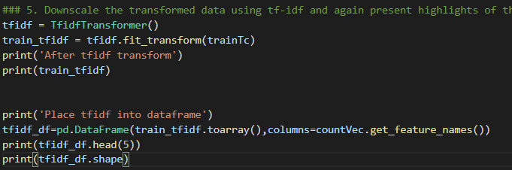
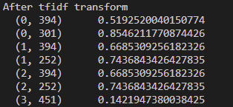
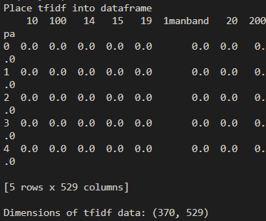
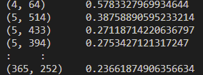

Tf-idf Transformer
Downscale the transformed data using tf-idf
Place data into dataframe for shuffle and split

Slide 8
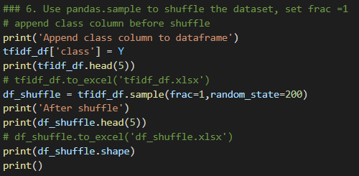
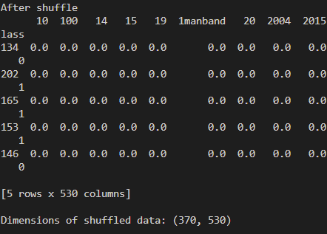
Shuffle the data
Append the class back to the data
Shuffle using pandas.DataFrame.sample with frac=1

Slide 9
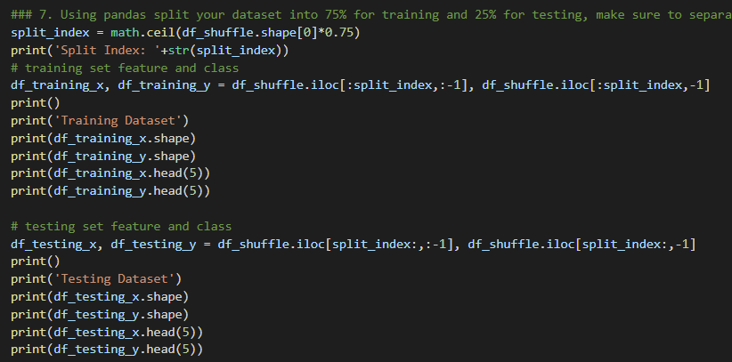
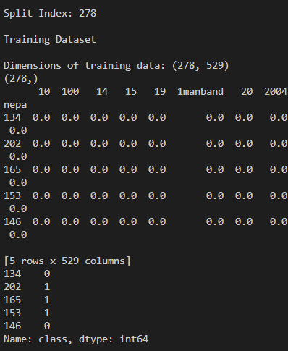
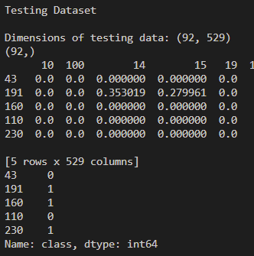
Test training split
Split the data into 75% training data and 25% of testing data
Total # of data = 370
# of training data = 370*0.75 = 278
# of testing data = 370-278 = 92
Split using pandas.DataFrame.iloc

Slide 10
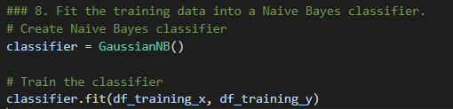
Naive Bayes classifier
Create Naïve Bayes Classifier
Train the classifier using the 75% training data

Slide 11
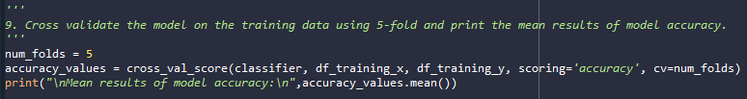
Cross validate the model
Cross validate the model on the training data using 5-fold
cross_value_score
Print the mean results of model accuracy
accuracy_value.mean()

Slide 12
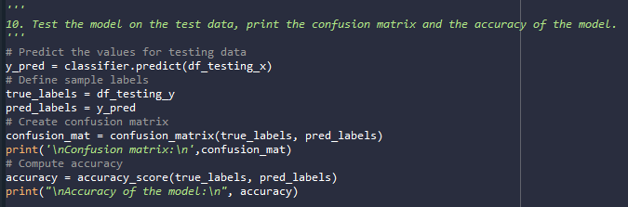
Test the model
Test the model on the test data
classifier.predict
Print the confusion matrix
confusion_matrix
Print the accuracy of the model
accuracy_score

Slide 13
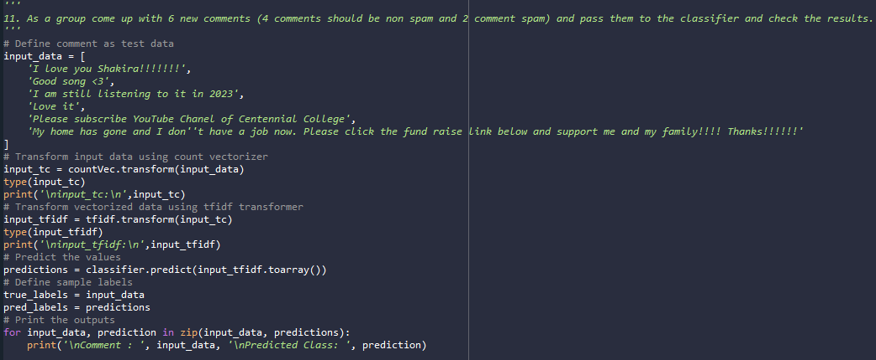
pass comments to Classifier and check results
Define comments
setting input_data
Transform comments using count vectorizer
countVec.transform
Transform vectorzed data using tfidf transformer
tfidf.transform
Predict the values
classifier.predict
Print result
zip comment and predictions and print result in for loop

Slide 14
conclusion
Model is highly accurate
confusion matrix
low FP: 6
low FN: 3
accuracy score
close to 1: 0.9021739130434783
Limitation
comment contains only symbols will be trimmed and classified as non spam
will have high FP if video content is related to spam wordings
short comments are difficult to identify

